Slide 1

Team mCIRCrna
Integration of circadian transcriptomes and snRNA sequencing to identify age and cell type dependent circadian gene signatures that demonstrate tissue chronicity in muscle
Team leader: Shufan Zhang
Team members:
Lisa Shrestha
Kristen Coutinho
Van Nha Huynh
Herminio Vazquez
Russel Santos

Slide 2
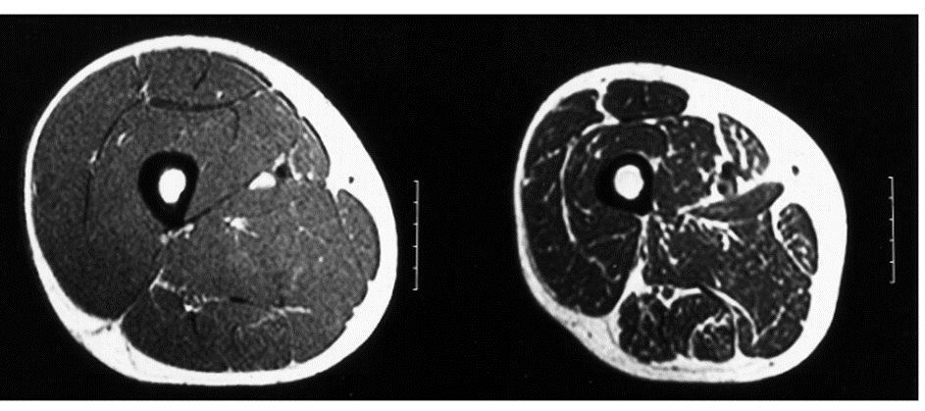
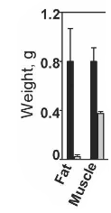
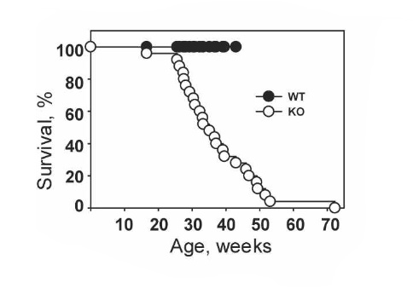

Background and Goals
Human 24 and 65 yr MRI thigh muscle
Jubrias et al. Pflugers Arch.1997
Aging is associated with muscle wasting and weakness
Muscle, a cellularly heterogenous endocrine organ, determines healthspan
Knockout of Bmal1, a core circadian clock gene, leads to muscle mass loss and decreased survival
Goal: Determine and characterize muscle circadian gene expression that is differential based on cell type and age
Kondratov et al. GENES & DEVELOPMENT 2006
Notes:
-Aging is associated with muscle wasting and seen here in these MRI cross- sections of 24 and 65 yr old human thigh muscle. This wasting results in increased likelihood of mortality.
-Muscle, a cellularly heterogenous endocrine organ, is a significant determinant of health span based on its own health
-Circadian gene expression can impact its health, as observed here in the circadian gene mouse knockout, where muscle mass was decreased in addition to overall survival.
-Our goal was to determine circadian gene expression that is differential based on cell type and age for potential drug targets.

Slide 3
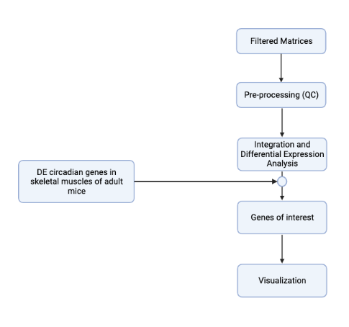
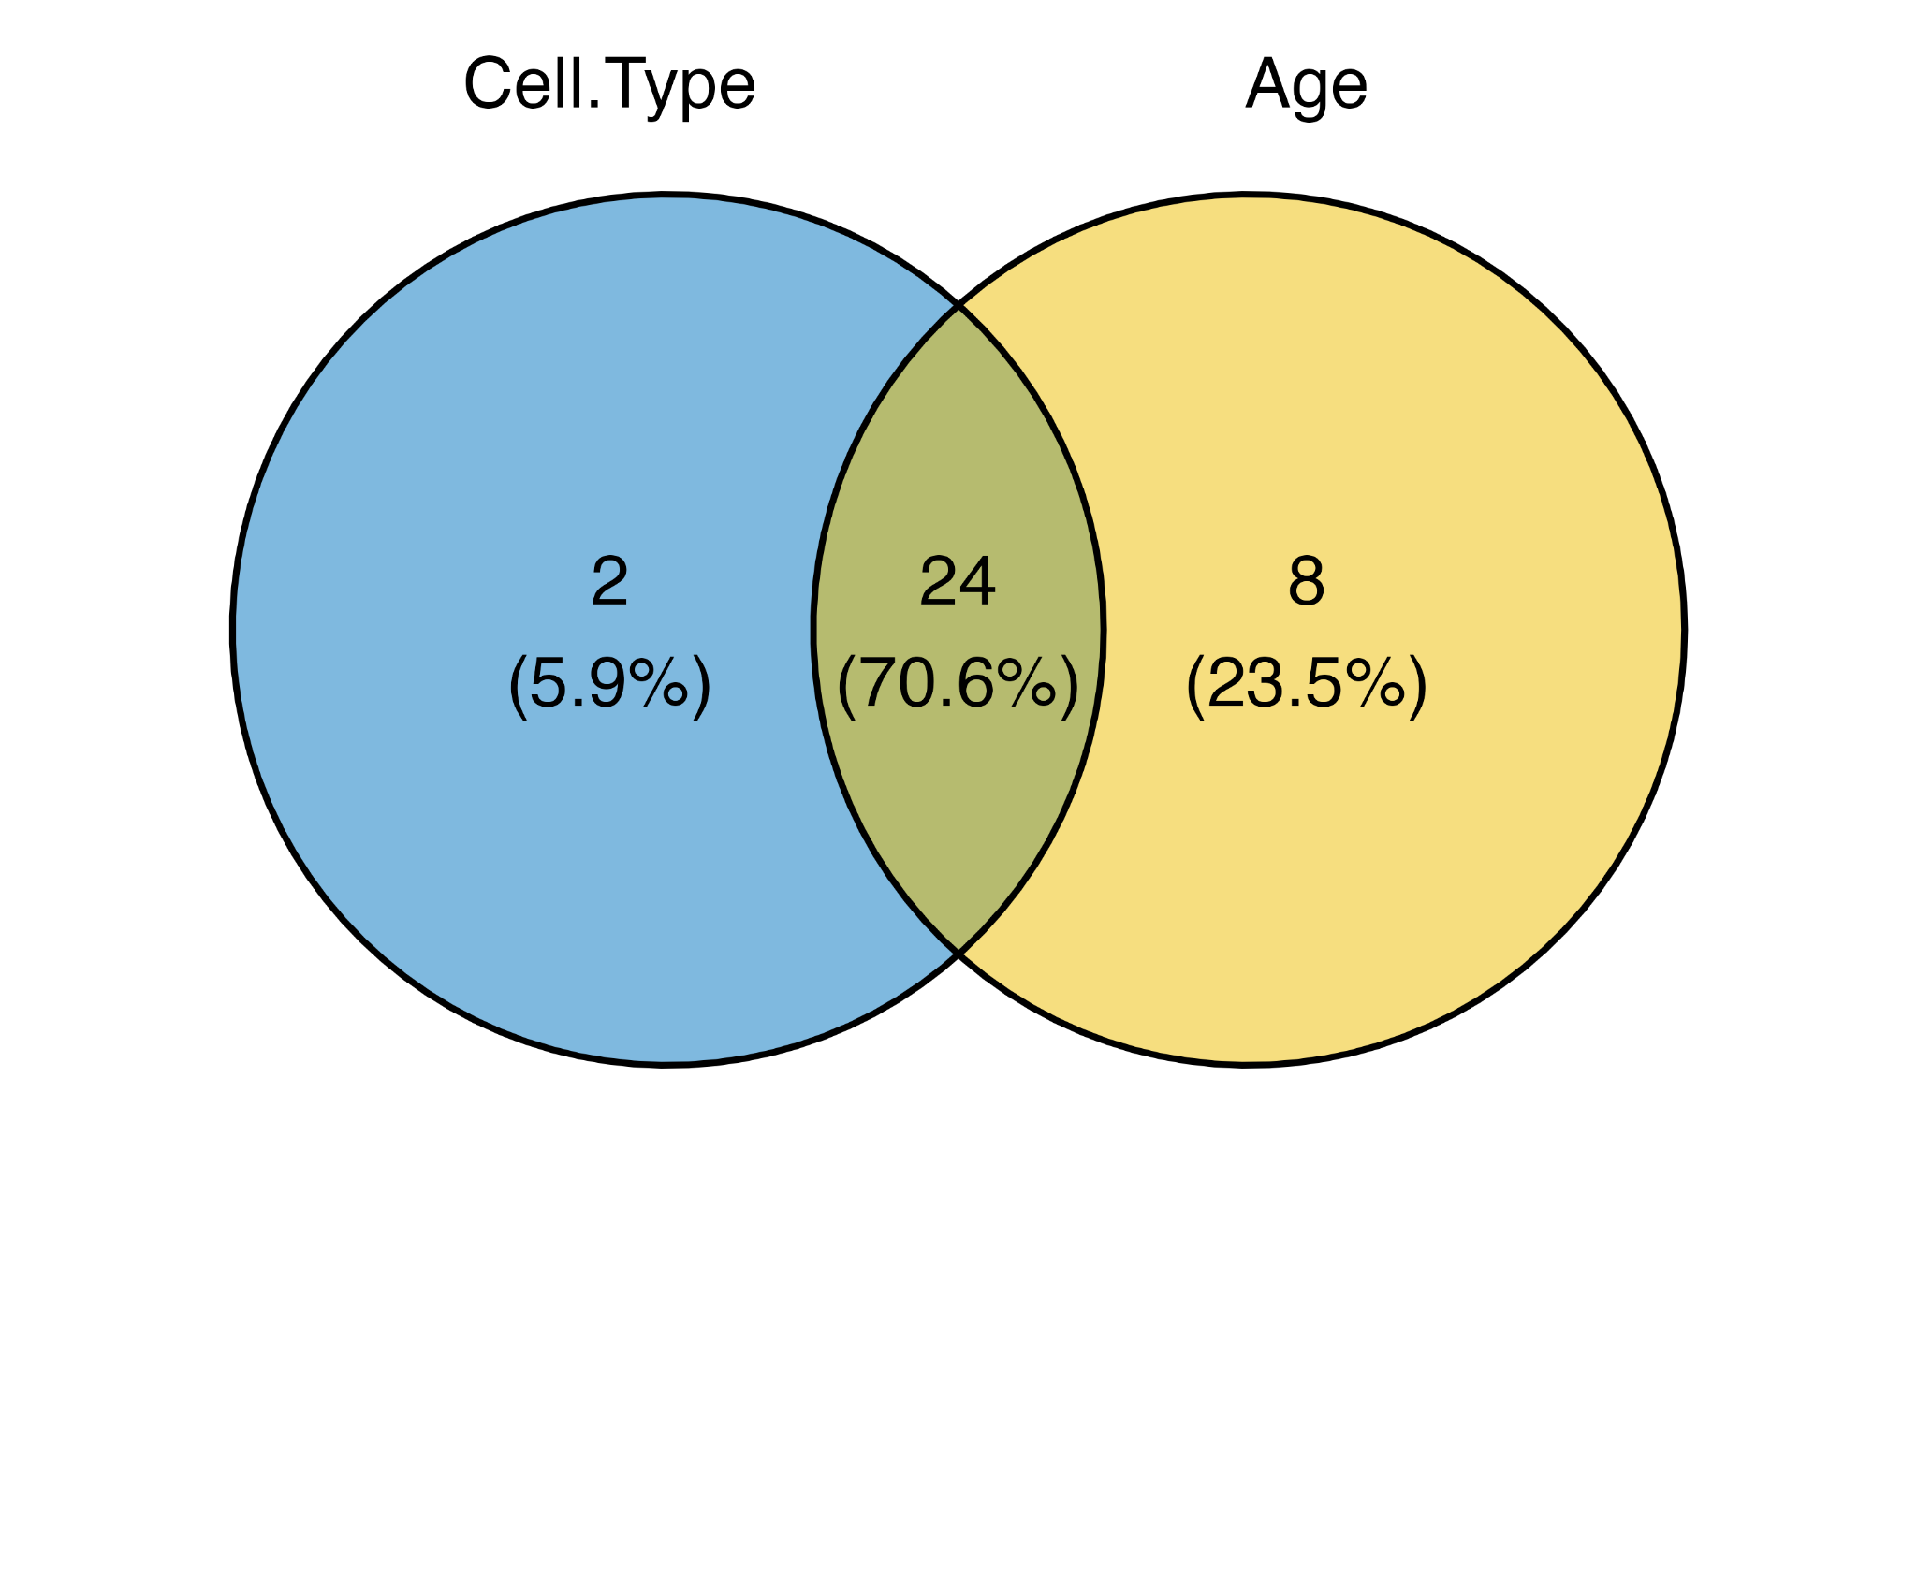
Analysis Workflow
snRNA-seq data from the tibialis anterior (TA) muscle of wild-type mice at 5-month and 24-month of age
Petrany et al., 2020
Seurat
R package (v.4.1.1)
McCarthy et al., 2007
total RNA was isolated from gastrocnemius muscles of wild-type mice at 7-10 week of age
215
McCarthy et al., 2007
Notes:
Gastrocnemius (calf muscle)
Filtered out genes that has less than 200 or more than 3200 features
Top 2000 features → PCA and UMAP
FeaturePlot () for visualization

Slide 4
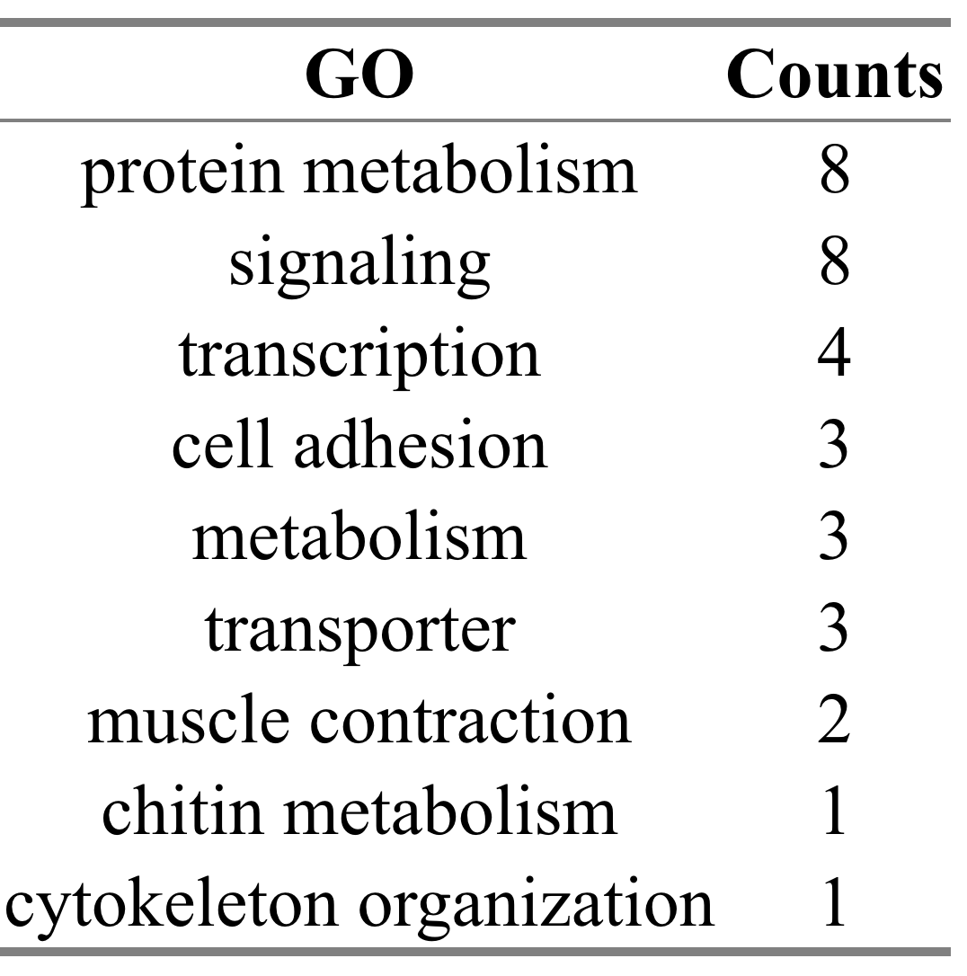
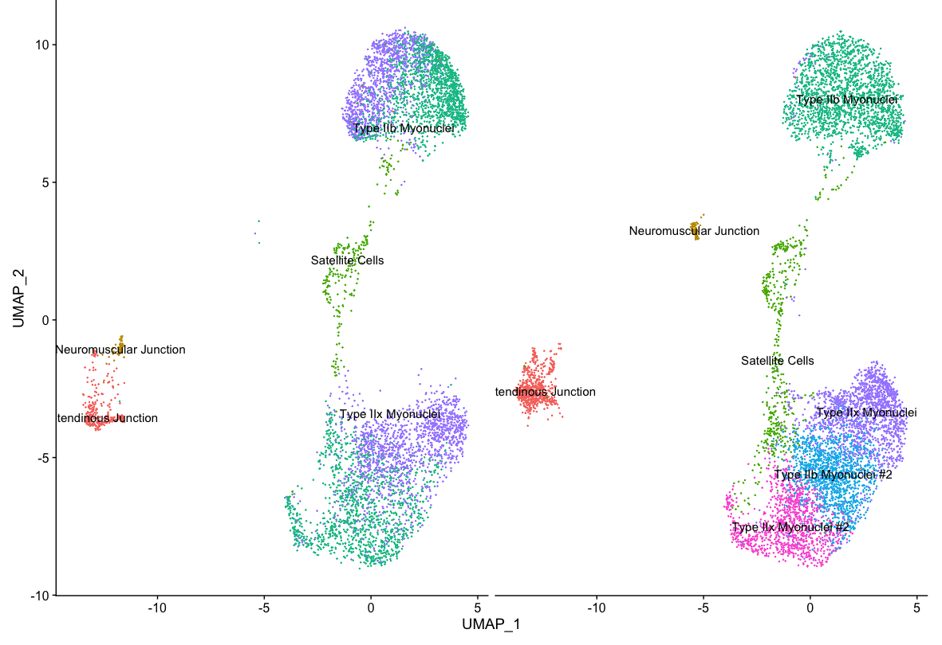
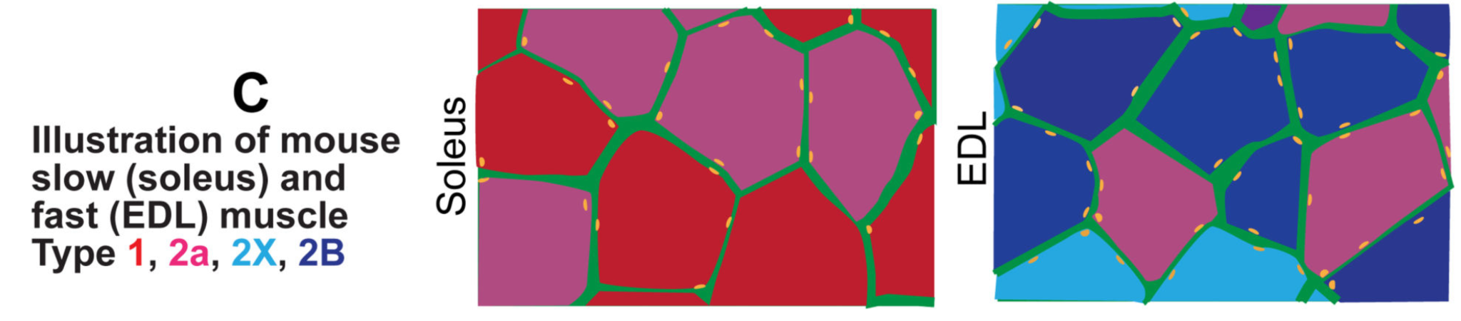
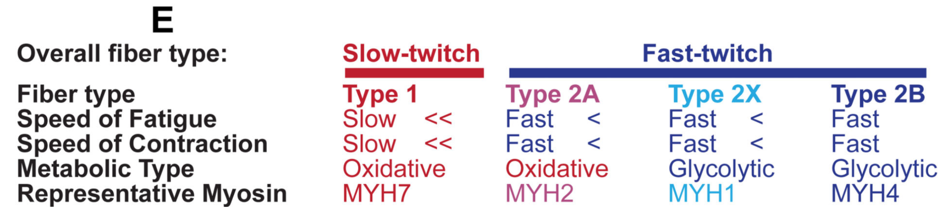
Visualizing cell-types in mice skeletal muscle samples at different age
5-month 24-month
Notes:
We focused our differential expression analyses on Type IIb and IIx muscle cells.

Slide 5
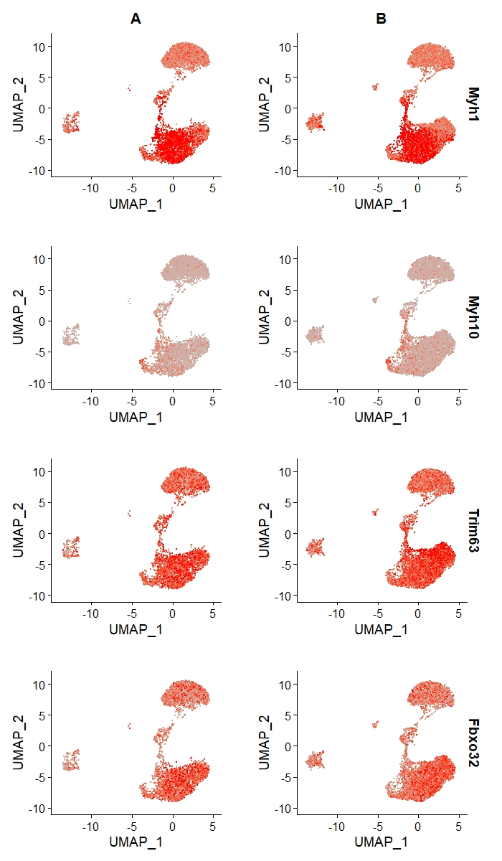
Circadian Genes When Cross-referenced to Single Nuclei Expression Reveal a Decrease in Aging of Powerful, Fatigue Resistant Fiber Expression
5-month 24-month
Increased muscle atrophy gene expression in Type IIx Myoclei
Notes:
In aging, in the region of 2x fibers, we saw an increase in expression of Trim63, a gene when overexpressed causes muscle fiber wasting and shinkage, known as atrophy.
This expression across age suggests a loss of type 2x fibers which would result in less fatigue resistant power capacity of the muscle in aging.
GO terms:
Myh1: striated muscle contraction (GO:0006941); ATP binding (GO:0005524);actin binding (GO:0003779);cytoskeleton organization and biogenesis (GO:0007010);motor activity (GO:0003774);muscle development (GO:0007517);
Myh10: striated muscle contraction (GO:0006941); ATP binding (GO:0005524);actin binding (GO:0003779);calmodulin binding (GO:0005516);cellular morphogenesis (GO:0000902);exocytosis (GO:0006887);motor activity (GO:0003774);muscle development (GO:0007517);neuronal migration (GO:0001764);plasma membrane repair (GO:0001778);protein amino acid alkylation (GO:0008213);protein binding (GO:0005515);smooth muscle contraction (GO:0006939);
Trim63: proteasomal ubiquitin-dependent protein catabolism (GO:0043161); muscle contraction (GO:0006936);protein binding (GO:0005515);ubiquitin-protein ligase activity (GO:0004842)
Fbxo32: ubiquitin cycle (GO:0006512); odorant binding (GO:0005549);protein binding (GO:0005515);transport (GO:0006810)

Slide 6
Circadian Genes When Cross-referenced to Single Nuclei Expression Reveal a Decrease in Aging of Powerful Fiber Expression and a Potential Fiber Type Switch State
5-month 24-month
Type IIb Myoclei Marker is down regulated at 24 month of age
Myh10 a marker for Type IIB muscle fiber is down regulated at 24 month of age.
Myh1 is marker for Type IIx muscle fiber, but it’s only differentially expressed in Type IIb cells.
Down regulation of Fbxo32 indicates muscle atrophy
Notes:
In aging we observed a decrease in Myh10, which is a marker for the very powerful Type IIB fibers in the Type IIB nuclei regions.
This was accompanied by a downregulation of the Fbxo32 gene, which also when overexpressed causes muscle atrophy.
The downregulation of the atrophy gene may be due to reduced nuclei of the Type IIB fibers.
Unexpectedly 2B nuclei express the 2X marker, Myh1 as a decrease through age.
This may be because the nuclei is a hybrid nuclei with 2B and 2x expression, contributing to the well know 2B-2x hybrid muscle fibers.

Slide 7







Acknowledgement
Mentors
Dr. Matt Alexander
Dr. Lara Ianov
Organizers

